Slide 1
STEM’s Levers of Change:
Questioning Homophobia’s Beginnings and Envisioning its end

Slide 2
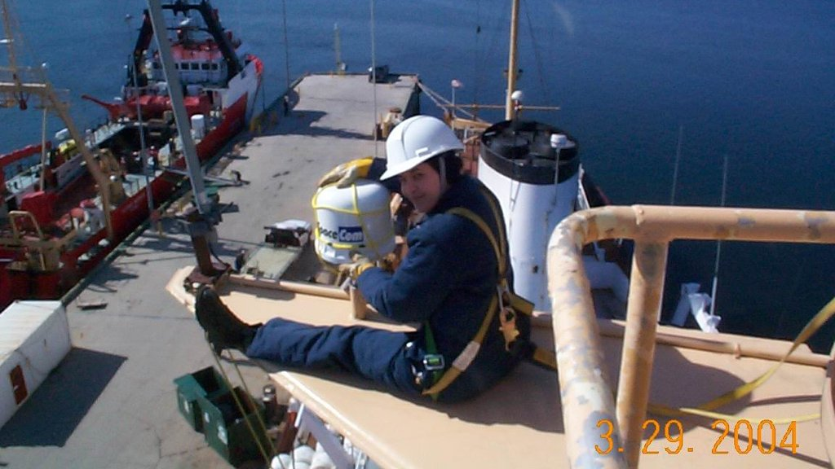

Slide 3


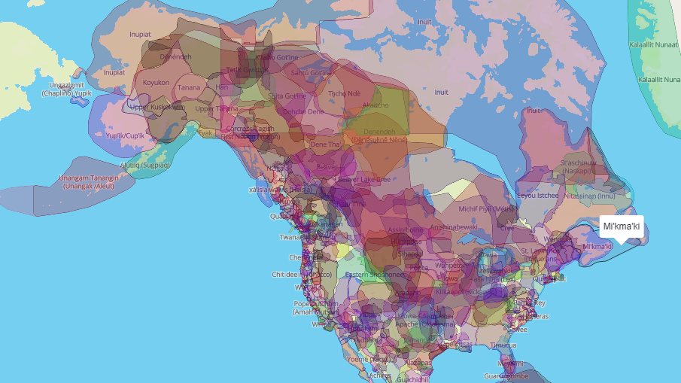
Native-land.ca

Slide 4
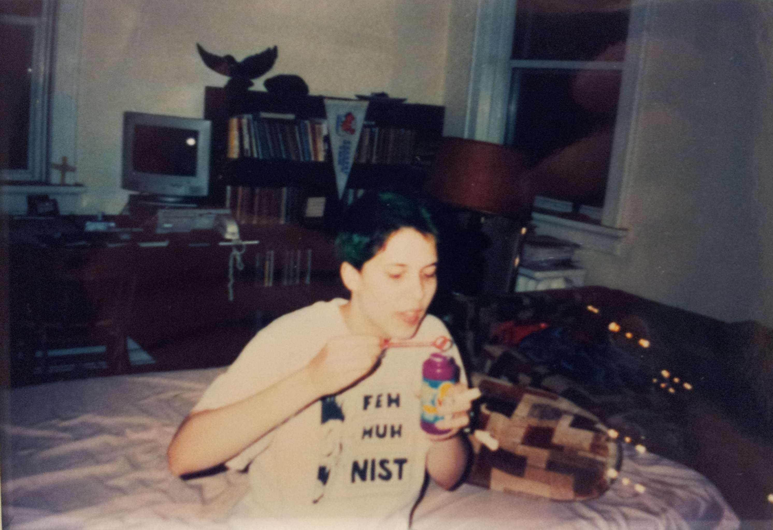

Slide 5
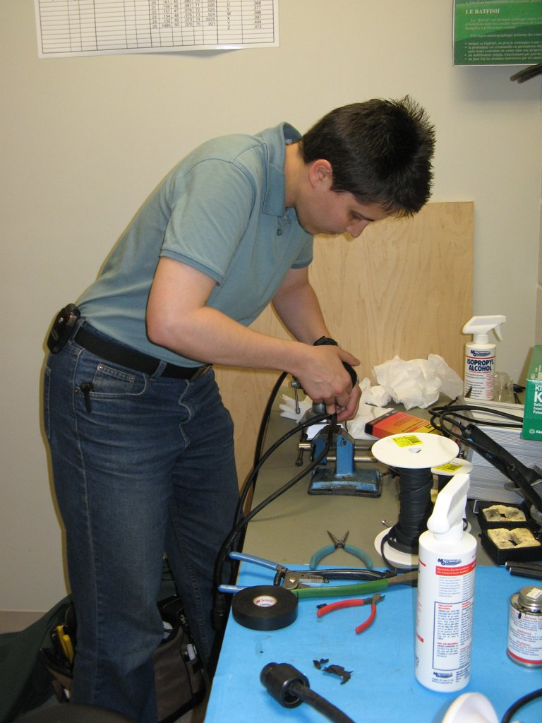

Slide 6
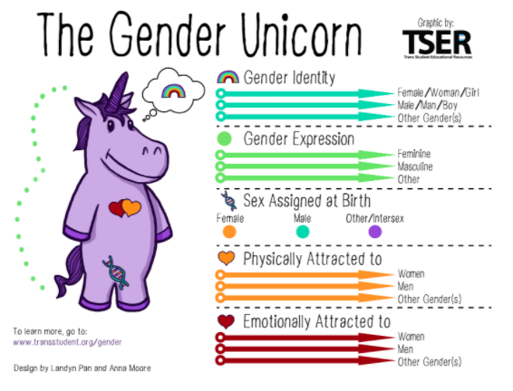

Slide 7
An ideology runs through it
1 correct answer
Incorrect = morally bad and wrong
Certainty
Rules
Breaking rules = punishment and/or humiliation
Panic/defensiveness/anger/conflict

Slide 8
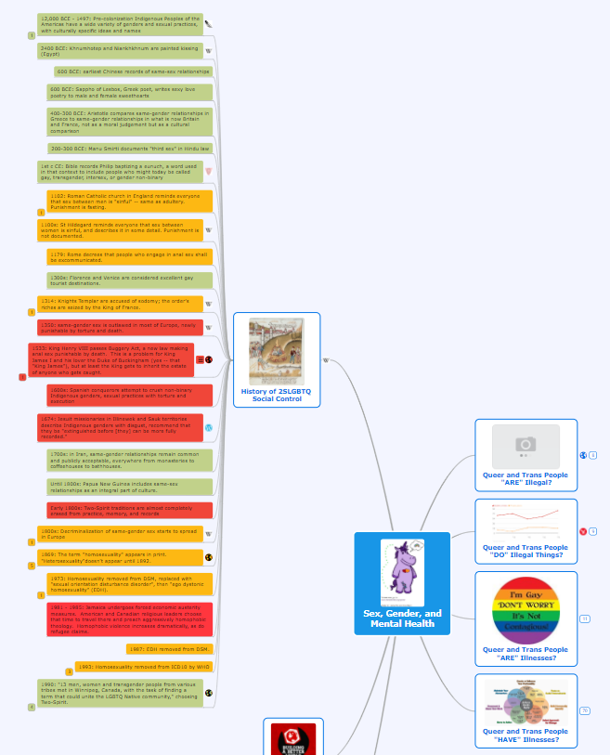

Slide 9
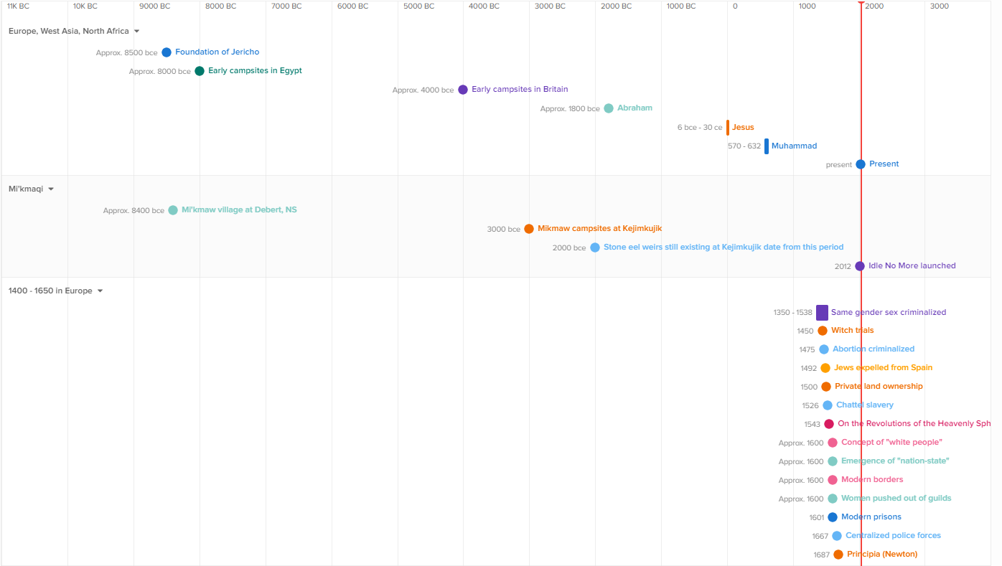

Slide 10
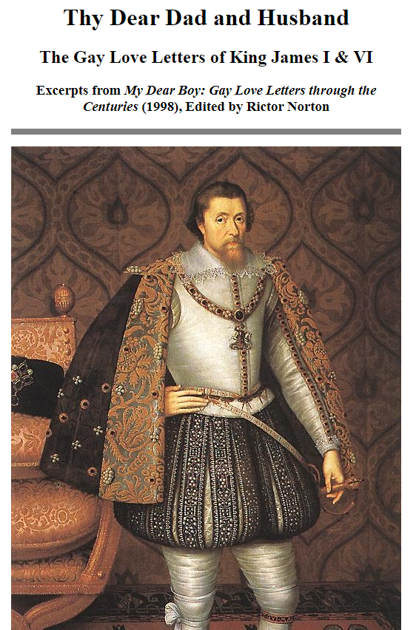

“You may be sure that I love the Earl of Buckingham more than anyone else, and more than you who are here, assembled. I wish to speak in my own behalf and not to have it thought to be a defect, for Jesus Christ did the same, and therefore I cannot be blamed. Christ had John, and I have George.” (King James)
In a letter to Lord Burleigh, [James gave] directives that Judges were to interpret the law broadly and were not to issue any pardons, saying that "no more colour may be left to judges to work upon their wits in that point.“ (also King James)
Authorized by… guess who?

Slide 12
An ideology runs through it
1 correct answer
Incorrect = morally bad and wrong
Certainty
Rules
Breaking rules = punishment and/or humiliation
Panic/defensiveness/anger/conflict

Slide 13
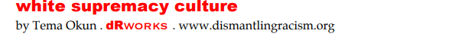
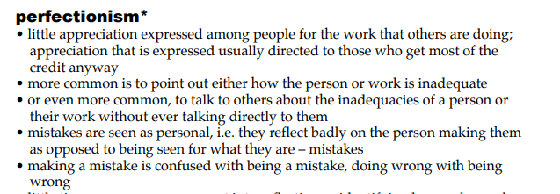
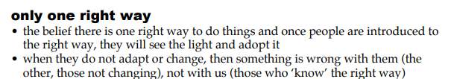
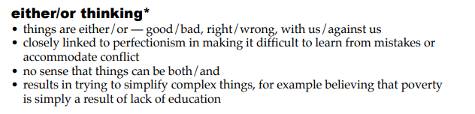

Slide 16
An ideology runs through it
1 correct answer
Incorrect = morally bad and wrong
Certainty
Rules
Breaking rules = punishment and/or humiliation
Panic/defensiveness/anger/conflict

Slide 17
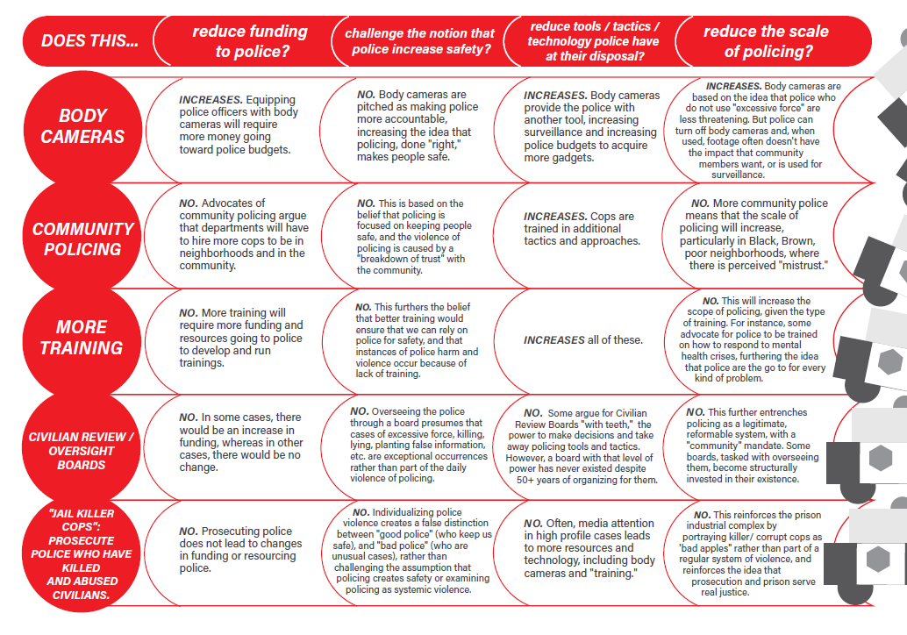

Slide 18
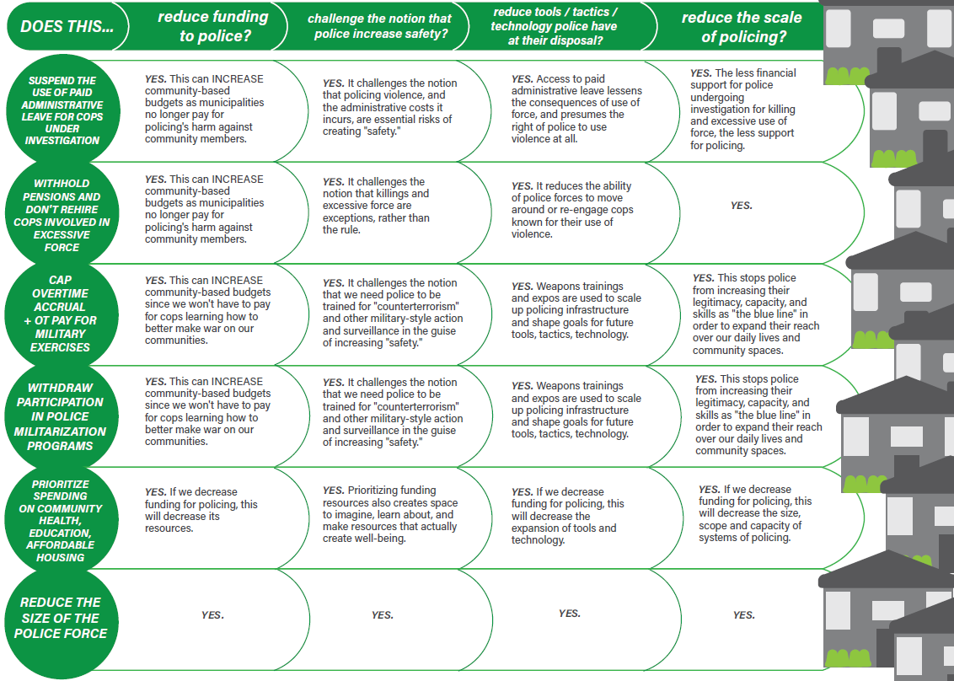

Slide 19

COPS OFF CAMPUS Research Project
Research campus police budgets

Slide 20
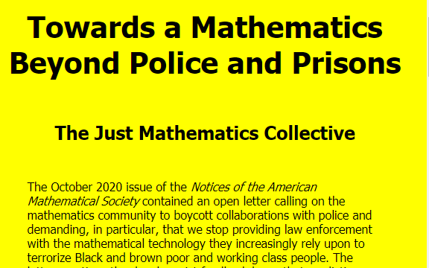
Just Mathematics Collective
Refuse to provide mathematical technology to police
Support students in finding other employment/internships
Set boundaries for writing letters of recommendation (police, military, weapons, surveillance/intel)

Slide 21
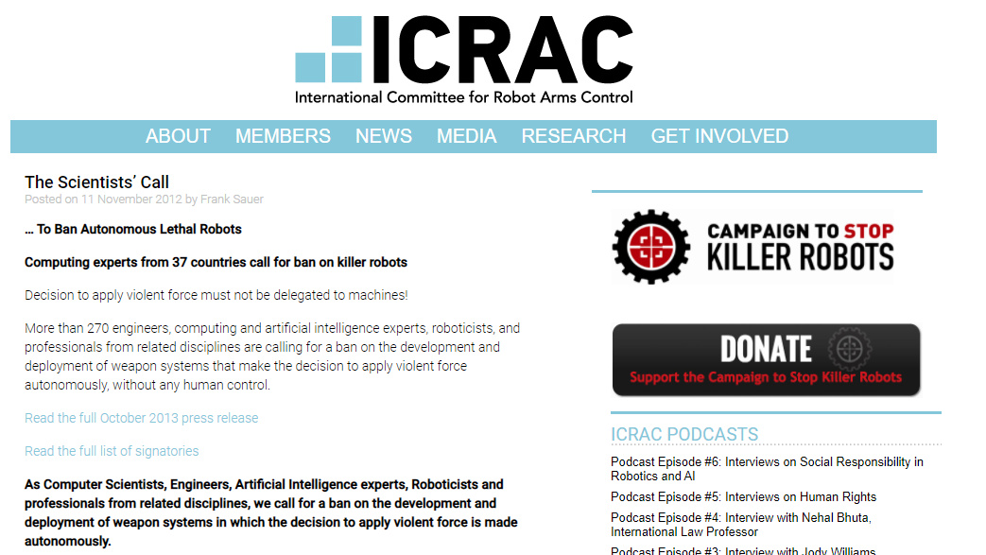
International Committee for Robot Arms Control
Campaign to Stop Killer Robots
Work toward international ban on fully autonomous weapons
Info and resources at autonomousweapons.org

Slide 22
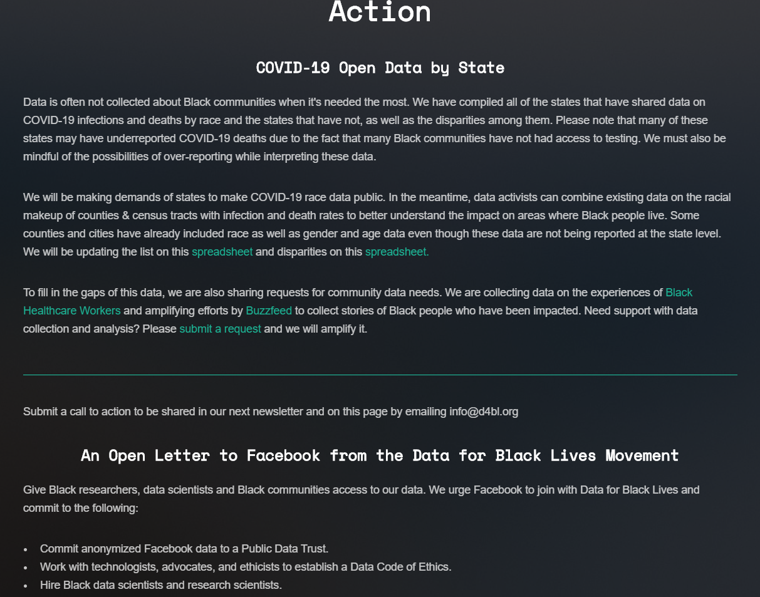


Slide 23
Roadblocks
Stuck On… | Try:
Getting consent vs. asking for education? | Invite, Don’t expect Support self-determination (free, prior, informed consent)

Slide 24
Roadblocks
Stuck On… | Try:
Getting consent vs. asking for education? | Invite, Don’t expect Support self-determination (free, prior, informed consent)
Trying to find the “right” answer? Or “It’s not my fault”? | Shifting from fear to accountability Generating multiple “good” answers and evaluating their pros/cons There are completely bad answers, but no completely good answers

Slide 25
Ways of Participating
Questioning the Guiding Principles to distract from them
    Questioning the Guiding Principles to exceed them or improve them
Examining Discomfort
Shaming
Slurs, threats, violence
Being passively entertained
Doing the most I know how
Courageous Imperfection
Punishing
Avoiding the work
Following the rules
Opening up about mistakes
Guided By
Control
Fear
Accountability
Inspired by Naomi Martey

Slide 26
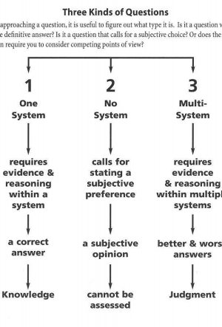
Miniature Guide to Critical thinking

Slide 27
Roadblocks
Stuck On… | Try:
Getting consent vs. asking for education? | Invite, Don’t expect Support self-determination (free, prior, informed consent)
Trying to find the “right” answer? Or “It’s not my fault”? | Shifting from fear to accountability Generating multiple “good” answers and evaluating their pros/cons There are completely bad answers, but no completely good answers
“Those” people seem “angry” or “divisive?” | Practicing hearing no Pressing pause on emotional expression Shifting from external locus of goodness to internal Find a practice buddy and role-play!

Slide 28
Roadblocks
Stuck On… | Try:
Getting consent vs. asking for education? | Invite, Don’t expect Support self-determination (free, prior, informed consent)
Trying to find the “right” answer? Or “It’s not my fault”? | Shifting from fear to accountability Generating multiple “good” answers and evaluating their pros/cons There are completely bad answers, but no completely good answers
“Those” people seem “angry” or “divisive?” | Practicing hearing no Pressing pause on emotional expression Shifting from external locus of goodness to internal Find a practice buddy and role-play!
People keep telling me I’m “centering whiteness” OR What if these positions scare people away? | Body scan Distinguishing emotions, sensations, and thoughts Who will be scared? Me? Who will be reassured?

Slide 29
Roadblocks
Stuck On… | Try:
Getting consent vs. asking for education? | Invite, Don’t expect Support self-determination (free, prior, informed consent)
Trying to find the “right” answer? Or “It’s not my fault”? | Shifting from fear to accountability Generating multiple “good” answers and evaluating their pros/cons There are completely bad answers, but no completely good answers
“Those” people seem “angry” or “divisive?” | Practicing hearing no Pressing pause on emotional expression Shifting from external locus of goodness to internal Find a practice buddy and role-play!
People keep telling me I’m “centering whiteness” OR What if these positions scare people away? | Body scan Distinguishing emotions, sensations, and thoughts Who will be scared? Me? Who will be reassured?
It’s going too fast | Analyze power dynamics (who’s driving the decisions?) Calibrate threats accurately (loss of job? Loss of life? Loss of friends?) Say things that might get you kicked out, or not invited back, or not paid, when possible. Act collectively to share the risk

Slide 30
To be Continued…
White parents and children: how do we talk about white supremacy?
Weapons advertising
Police nationalism (Jeff Sharlett)

Slide 31
Alicia Elliott
“It's important for Canadians to remember: Indigenous people were willing to share our lands with you. We only asked that you let us keep our ways, our languages, our children--and that you be responsible to the lands and waters, since we ALL rely on them.
Canada has refused.
What's more: by not worrying about the state of the lands, water and air, your Canadian leaders are showing they don't care for you or your children at all. They only care about helping big oil and gas companies, mining companies, extractive capitalism.
Why must we all suffer?
And for what? For the billionaires to gobble up even more of our world's finite resources? For the billionaires to have offshore accounts where they don't pay their fair share of taxes while racist white folks yell about Indigenous people who do pay taxes? How does this help you?
EVERY SINGLE ACTION that EVERY LEVEL of Canadian government has been making in the midst of this global pandemic has shown they don't actually care about our survival. So why are we invested in their political survival? Why are we putting our faith in those who always fail us?”

Slide 32
Police Nationalism (Jeff Sharlett)
Fetishizing force as “law”
Relieving oneself of having to think about what law is
Secularization of authoritarian faith, with fixed, received “order”
Similar to fundamentalist “natural law” but state power replaces divine
Underlying meaning twists to suit context – not concerned with internal consistency
Endorsing violence (esp. from police) as benevolence
Replacement of civil authority with armed state power

